Slide 1


A
Summer Training Report
At
“SURAT-TAPI DISTRICT CO-OPERATIVE MILK PRODUCERS’ UNION LIMITED
(SUMUL DAIRY, NAVI PARDI)”
BACHELOR OF BUSINESS ADMINISTRATION
SUBMITTED BY:
Name of Student | Roll No
Dev B. Modi | 209
Raj B. Mistry | 205
Hitesh B. Patil | 278
Miral M. Patel | 258
Jaykumar A. Patel | 250
Zeelmeel D. Dafda | 057
UNDER THE GUIDANCE
Mrs. Jalshri Dave
SUBMITTED TO
SDJ International College

Slide 2
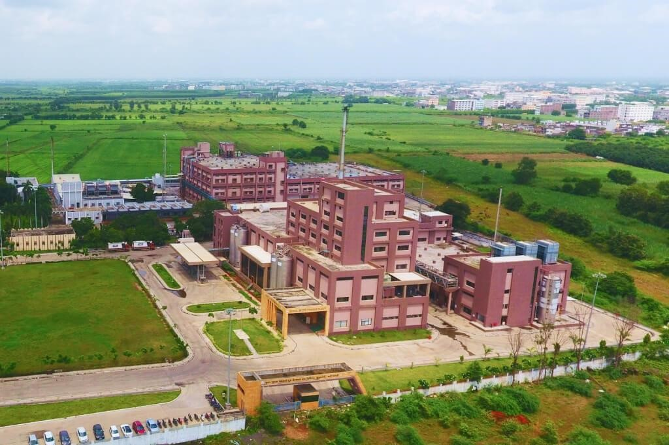
GENERAL INFORMATION
HISTORY
FOUNDER >>>> Morarji Desai
OWNER >>>> Rupesh Goswami
Sumul Dairy (Surat) – 22 August 1951
Sumul Dairy (Navi Pardi)
Bakery Plant – 3 November 2017
Ice cream Plant – 2017
Powder Plant – 2017
AWARDS
Shri Nimish Vashi Award for outstanding performance in environment protection and pollution control.
Colortex Award for Outstanding Performance in Energy Conservation.
National Energy Conservation Award
Limca Book of Records
Green Award

Slide 3

GENERAL INFORMATION
MISSION
To provide Quality milk & milk products to customer in Surat.
VISION STATEMENT
We are socially responsible Organization with commitment to Milk Producer's by providing good returns and services, to consumer's safety and delight through implementation of Food Safety and Quality management System. We believe in growth and continual improvement through teamwork, trust, and excellence, without compromising Food Safety, Quality, Honesty, Honesty and Integrity.
VALUE
Excellence
Cooperation
Honesty
Dedication
Ownership
Transparency
Teamwork
Trust And Courage
Self-Leadership

Slide 4
GENERAL INFORMATION
SWOT ANALYSIS
STRENGTHS
Investment in Technology
Production Capacity, Quality
Strong Brand Value
Large Consumer Base
OPPORTUNITIES
High per capita Milk consumption
International Expansion
Expansion of Product Portfolio
S
O
WEAKNESS
High Operational Cost
Frequent Legal Issues
Lack of Success in Certain Areas of Portfolio Expansion
THREATS
High per capita Milk consumption
International Expansion
Expansion of Product Portfolio
W
T

Slide 5
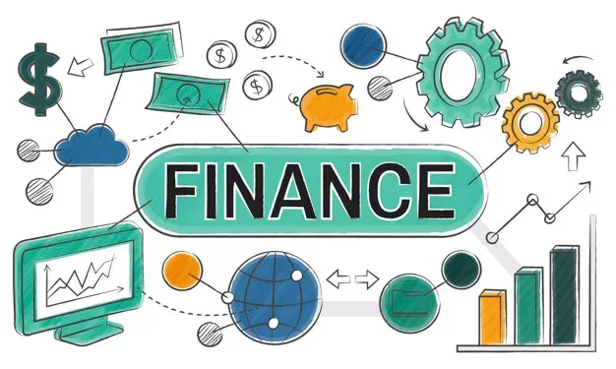
FINANCE DEPARTMENT
INTRODUCTION
Finance management is that managerial activity which is concerned with the planning and controlling of the firm's financial activities and manages the financial resources.
"Finance management means the use of such managerial function as planning and control to undertake finance function.”

Slide 6
FINANCE DEPARTMENT
RATIO AND THEIR INTERPRETATION
RATIO ANALYSIS
PARICULAR | FY19 | FY20 | FY21
Current Ratio | 1.3 | 1.06 | 1.63
Gross Profit Ratio | 4.7 | 4.1 | 4.5
Net Profit Ratio | 0.15 | 0.14 | 0.15
Return on Capital Employed | 5.16 | 4.6 | 4.06
Return on equity shareholders' fund | 10.47 | 10.72 | 11.14
Proprietary Ratio | 0.07 | 0.09 | 0.07
Stock turnover ratio | 20 times | 24 times | 18 times
Fixed asset turnover ratio | 12.93 | 15.47 | 14.61
Total assets turnover ratio | 5.57 | 6.2 | 6.1
Debt equity ratio | 2.5 | 0.86 | 3.5

Slide 7

FINANCE DEPARTMENT
ACCOUNTING PROCEDURE
Further the payment, made by Sumul Dairy is coordinated with the Accounts department to keep the record of the milk received and to maintain the account for it in the following manner.
Collection of sales bills & sales data
Data verification with sales information
Feed concern data in computer
Feed duration data in computer
To pass duration entry to the computer.
To the Milk Producers
To the Transporters

Slide 8

MARKETING DEPARTMENT
Most people define marketing as selling or advertising. It is true that these are parts of the marketing. But marketing is much more than advertising and selling. In fact, marketing comprises of several activities which are interlinked and the decision in one area affects the decision in other areas.
Marketing plan through digital marketing:
Facebook marketing page: 22,000+ followers.
Facebook official page: 4,300+ followers.
Instagram official page: 2,500+ followers.
Digital marketing handle by “Stare Galaxy” company.

Slide 9
MARKETING DEPARTMENT
MARKETING PLAN
PROMOTING TOOLS USED
Big Hoardings in Different parts of the city.
Radio FM 98.3.
Newspaper Pamphlet.
Use of Leaflets at regular intervals.
Wall Painting.
Delivery Truck painting.
Free glow signboards to agents.
Free shop painting of agent.
Distribution of “Sumul baby care” book.
Offline Marketing
Advertisement
Newspaper Pamphlet
House Pamphlet
Salesperson
Online Marketing
Digital Marketing

Slide 10
MARKETING DEPARTMENT
DISTRIBUTION CHANNEL
Production
Distributor
Retailer
Customer
Production
Distributor
Salesmen
Retailer
Customer
Production
Retailer
Customer
(1)
(2)
(3)
Segmentation
Kids: Cookies, Muffins
Youth: Khari, Bread, Namkeen, Makhania
Health Conscious: Moji Cookies (Manufacturing Only for below 6 Years children for government medical camp at regional areas.)

Slide 11
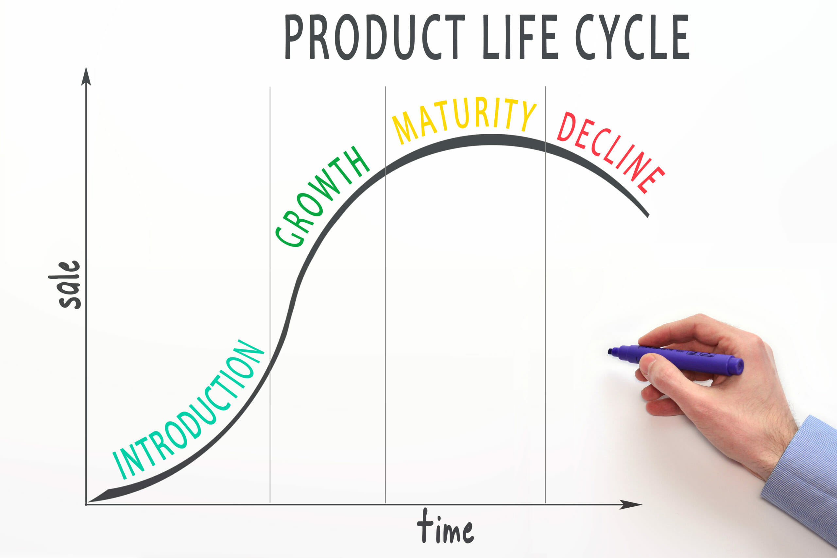
MARKETING DEPARTMENT
PLC (PRODUCT LIFE CYCLE)
Introduction
Growth
Maturity
Decline
(1)
(2)
(3)
(4)
PRICING METHOD
Generally, the pricing policy is not disclosed to anyone, and so confidential information was also not disclosed regarding the pricing policy.
Sumul Dairy is following FMP (Fixed Margin Policy) where company charges 25-30% of margin on their prices. At present, the company is following “Cost Plus Margin method”.

Slide 12
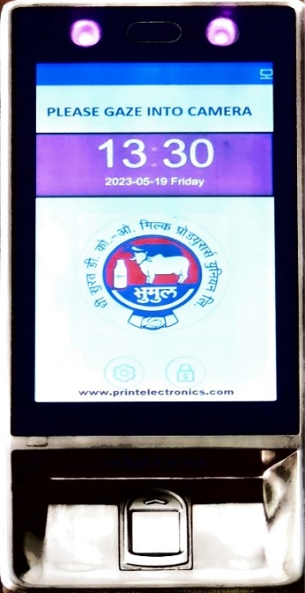
HRM / PERSONNEL DEPARTMENT
Human Resource Management (HRM) is the practice of recruiting, hiring, deploying and managing an organization's employees.
RECRUITMENT PROCEDURE
Sources of Recruitment
Internal Sources
External Sources
ATTENDANCE MAINTENANCE
SELECTION PROCESS
For Executives
For Non-Executives
NUMBER OF EMPLOYEES IN SUMUL
Total Permanent Employees: 168
Total Apprentice: 28

Slide 13
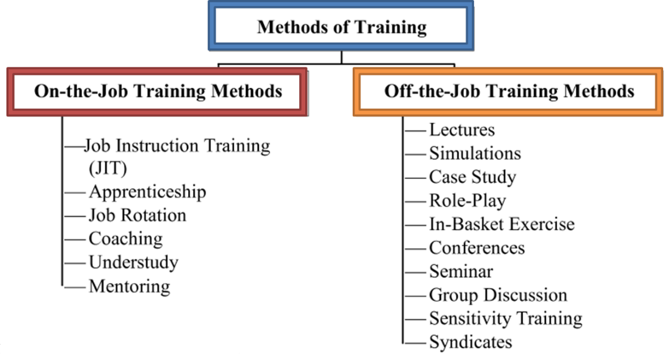
HRM / PERSONNEL DEPARTMENT
TRAINING GIVEN
WAGES & SALARY ADMINISTRATION
Dearness Allowance
Additional Dearness Allowance (ADA)
House rent Allowance (HRA)

Slide 14
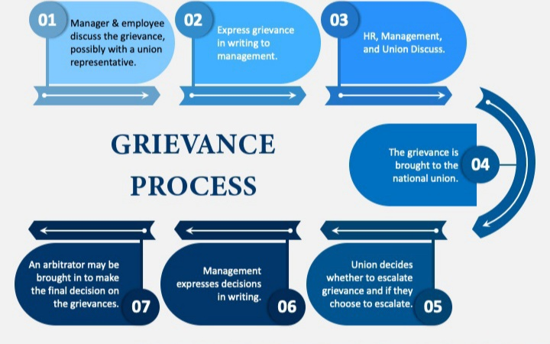
HRM / PERSONNEL DEPARTMENT
LEAVE RULES
Oracle Software
All
Employee Code
Detail Leave List
Reason
HOD Permission
Save
GRIEVANCE HANDLING PROCEDURE

Slide 15
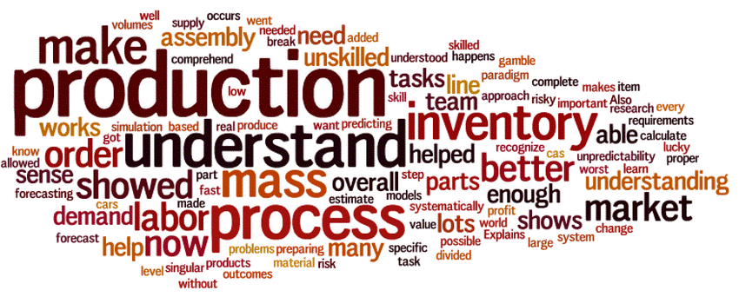
PRODUCTION DEPARTMENT
A Production Department is a fully functioning department that converts raw materials, assembles components into finished goods, and packages them.
It may employ mechanics, machine setup specialists, maintenance personnel, and machine operators.
TYPES OF PLANT
Ice cream plant
Powder plant
Bakery plant
Raw Material Used
System Used

Slide 16
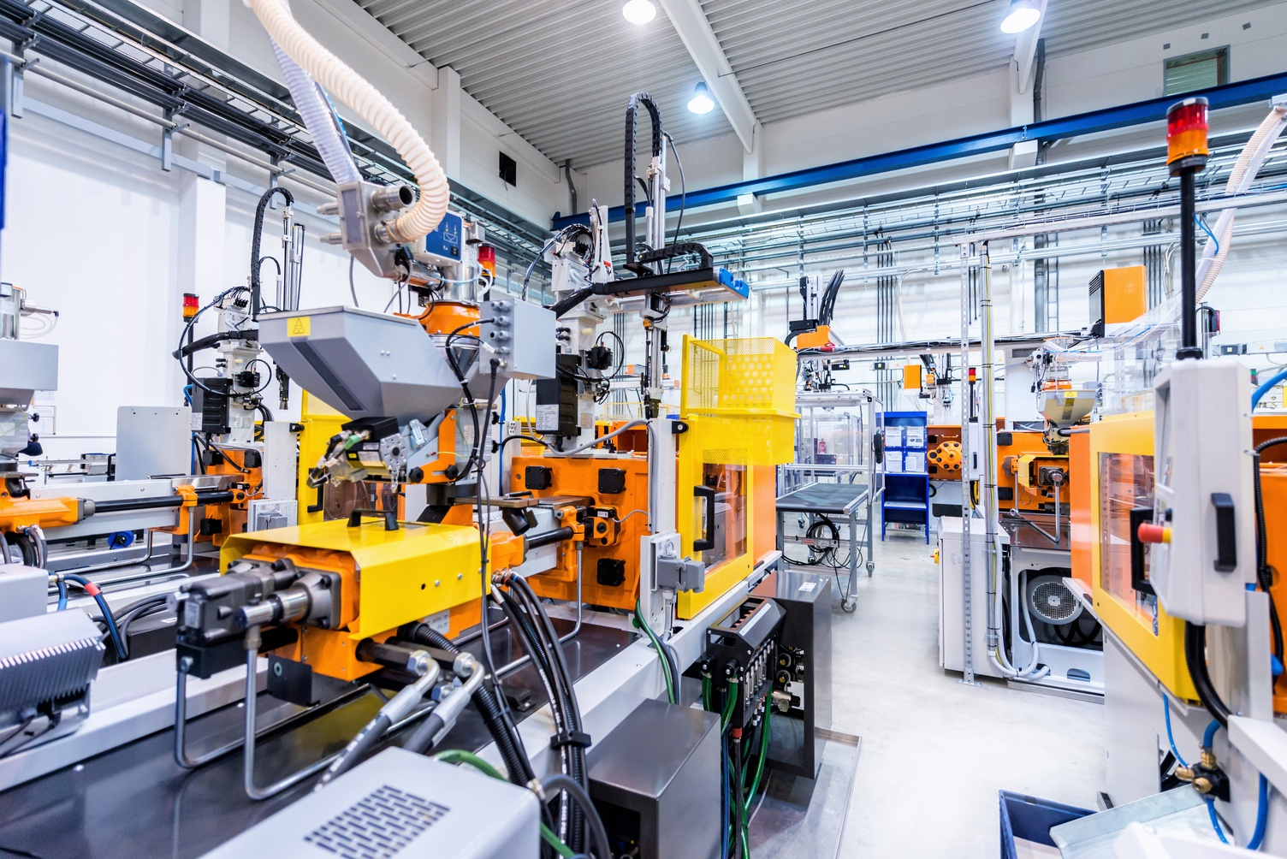
PRODUCTION DEPARTMENT
HEAVY MACHINERIES USED
Bakery
Dough Sheeter
Tunnel oven
Rotary type Rack oven
Proofer
Cooling tunnel
Horizontal flow warp machine
Ice-cream Plant
Pasteurizer (3000 Liter)
Homogenizer
Wrapping Machine
Filing Machine
Power Plant
Balance tank
Evaporator
Spray dryer
Vibro fluidizer

Slide 17
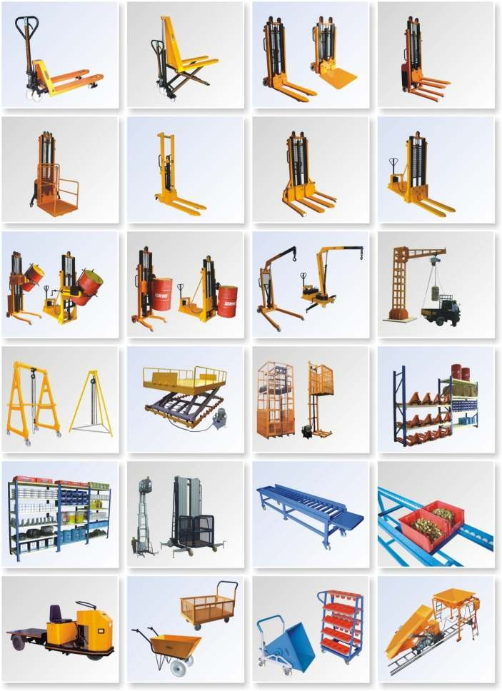
PRODUCTION DEPARTMENT
DESCRIPTION OF LAYOUT
MATERIAL HANDLING EQUIPMENT USED
Pipeline
Hydraulic Pallet Truck
Conveyer belt
Barrels
Crates
Plastic pallet
INVENTORY CONTROL METHOD
ORDER QUANTITY, LEAD TIME, REORDERING LEVEL
QUALITY CONTROL

Slide 18
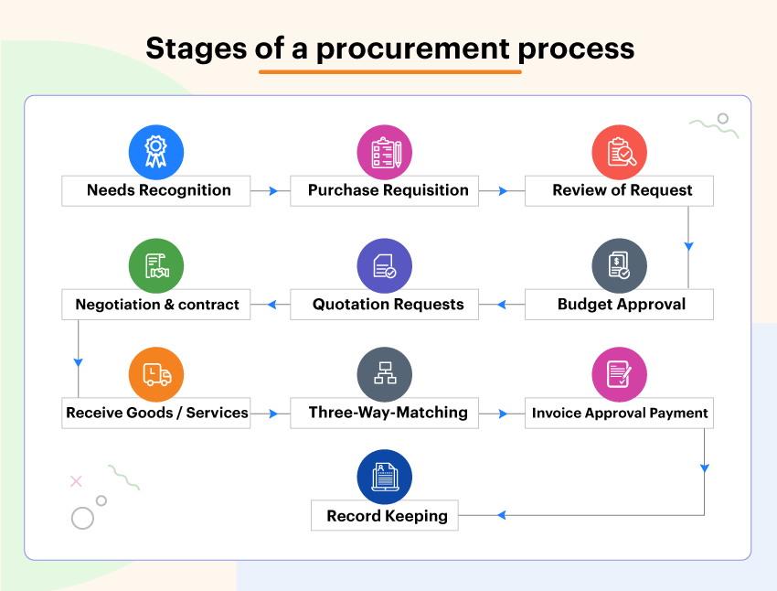
OTHER DEPARTMENT
PURCHASE DEPARTMENT
The purchasing department of a company is responsible for procuring the goods, raw materials & services required to operate the organization effectively .Now, every organization has its specific needs when it comes to the sourcing and procurement of equipment, raw materials, and services.
PURCHASE PROCEDURE

Slide 19

OTHER DEPARTMENT
SAFETY DEPARTMENT
Safety is a state in which hazards and conditions leading to physical, psychological, or material harm are controlled to preserve the health and well-being of individuals and the community.
FIRE EXTINGUISHERS
A fire extinguisher is a handheld active fire protection device usually filled with a dry or wet chemical used to extinguish or control small fires, often in emergencies. There are different fire extinguishers used in different departments. In Sumul, there are approximately 100+ fire extinguishers.
Five main types of fire extinguishers
Water, water mist or water spray fire extinguishers
Foam fire extinguishers
Dry Powder – standard or specialist fire extinguishers
Carbon Dioxide (‘CO2’) fire extinguishers
Wet Chemical fire extinguishers

Slide 20
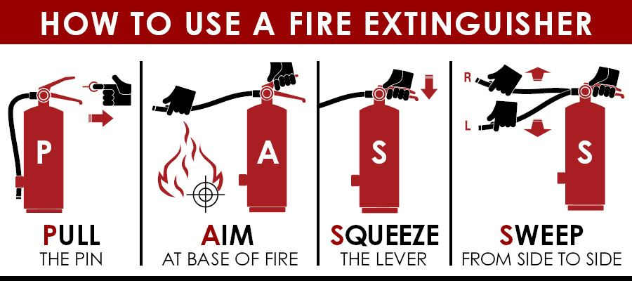
OTHER DEPARTMENT
SAFETY DEPARTMENT
How to use a fire extinguisher
SAFETY EQUIPMENT PROVIDED TO WORKERS
Bouffant cap - used in the production department.
Gloves - used in material mix, production & packing.
Jacket - used in cold storage.
Apron - used in material mixing & production.
Shoes - used in cold storage.
HEALTH AND SAFETY POLICY

Slide 21
CONCLUSION
Training in the summer is an integral part of management studies as it provides students with industry opportunities and experience of working in a corporate environment. Sumul Dairy's management of ice-cream, bakery, and SMP (Skimmed Milk Powder) processing, as well as their marketing and distribution efforts, are impressive. It's noteworthy that they provide ice-cream throughout India under the brand name of “Amul”.
Despite being a cooperative society, Sumul Dairy has established a reputation for operating in a highly professional manner. This speaks to their commitment to efficient and effective management practices. Their ability to handle various aspects of the dairy business, from processing to marketing and distribution, demonstrates their expertise and dedication to delivering quality products to consumers across the country.
By successfully managing these operations, Sumul Dairy showcases the advantages of a cooperative model in the dairy industry.

Slide 22
LEARNING OUT OF REPORT
From this project we learn how the knowledge and principles learned in theory are translated into practical solutions and operations. By witnessing the practical implementation of dairy technology, we can gain a deeper understanding of the challenges faced by the industry and the innovative approaches used to overcome them. We are interacting with employees at all levels of Sumul Dairy and receiving a positive response is a great indicator of the company's commitment to fostering a supportive and collaborative work environment. A cordial work atmosphere plays a vital role in promoting teamwork, communication, and employee satisfaction.
By this training we get Industry Knowledge, Practical Skills, Work Culture and Professionalism, Networking Opportunities, and Understanding Best Practices.
Absolutely! The training we received at Sumul Dairy will undoubtedly give benefit in our future endeavors.

Slide 23


